Slide 1
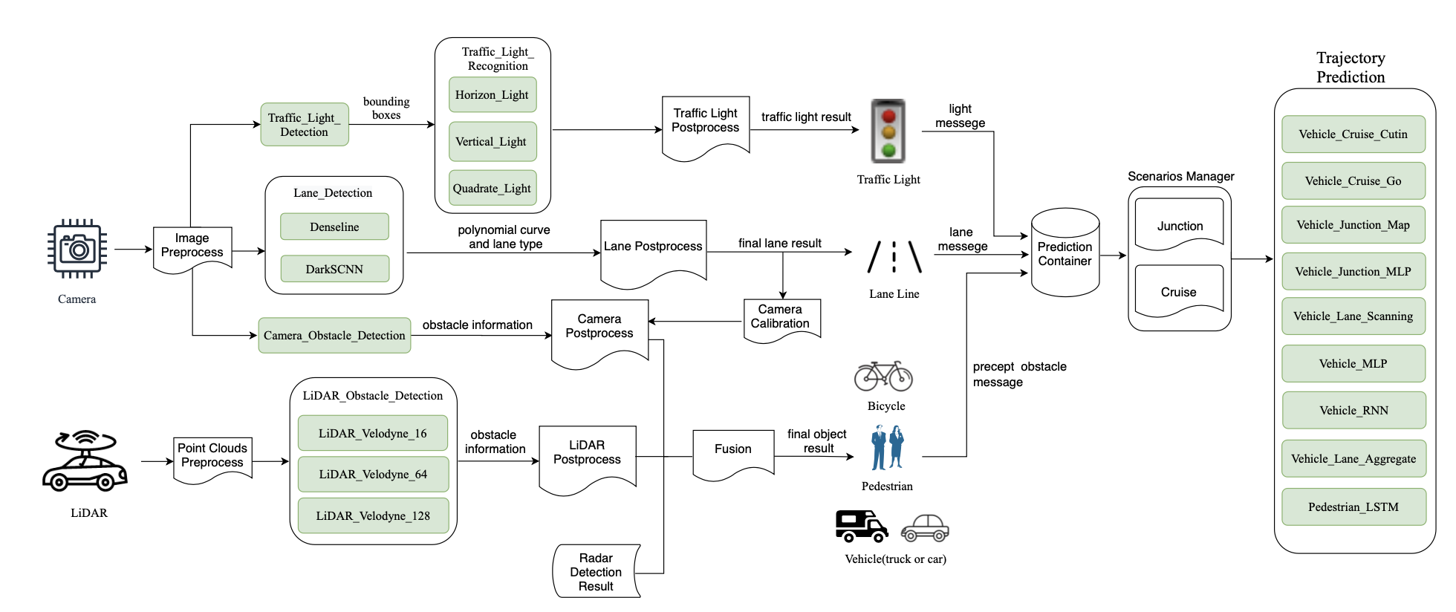
DL System Architecture
[1] Peng et al, 2020 FSE. A first look at the integration of machine learning models in complex autonomous driving systems: a case study on Apollo
Notes:
无人驾驶系统是个典型的复杂AI System
从某一条线可以开始，测出来某一条线
traffic light
1. 看model interaction bug, mode and code interaction bug, 从empirical study开始
2. 跑Appolo, 看一下Appolo的测试怎么搞
仿真系统，

Slide 2


IntentClassifier
component
Preprocess
Intent
Classifier
User Message
Is contained
Postprocess
Intent
Fallback
Selector
Featurer
Tokenizer component
Featurizer
component
Selector component
Policy
component
Preprocess
Preprocess
Featurer
Preprocess
DST
Preprocess
Policy
Ensemble
Tokenizer
Featurizer
Selector
Policy
Is contained
Postprocess
Postprocess
Postprocess
Postprocess
Entity
Symptom Mapper
Featurer
EntityExtractor component
Action
Preprocess
entity
Entity
Extractor
Postprocess
Is contained
Notes:
Module级别的图，所有可能的数据依赖。
Fallback classifier, entity symptom mapper放到后处理的模块里面。
参考Apollo的图，把一些中间数据，数据流的线也加进去
放到methodology后面，每个RQ都有methodology的一段

Slide 3
IntentClassifier
component
Preprocess
User Message
Intent
Classifier
Is contained
Postprocess
Intent
Fallback
Selector
Featurer
Featurizer
component
Selector component
Policy
component
Tokenizer component
Preprocess
Featurer
Preprocess
DST
Preprocess
Policy
Ensemble
Featurizer
Selector
Policy
Preprocess
Postprocess
Postprocess
Postprocess
Is contained
Tokenizer
Postprocess
Featurer
EntityExtractor component
Entity
Symptom Mapper
Preprocess
entity
Action
Entity
Extractor
Postprocess
Is contained
Notes:
Module级别的图，所有可能的数据依赖。
Fallback classifier, entity symptom mapper放到后处理的模块里面。
参考Apollo的图，把一些中间数据，数据流的线也加进去
放到methodology后面，每个RQ都有methodology的一段

Slide 4
IntentClassifier component
Preprocess
Intent:
Intent1
Intent2
Intent3
…
Intent
Classifier
User Message
Postprocess
Fallback
Selector
Featurer
Tokenizer component
Selector component
Policy component
Featurizer
component
Preprocess
Featurer
Preprocess
DST
Preprocess
Action
Preprocess
Policy
Tokenizer
Featurizer
Selector
Postprocess
Postprocess
Postprocess
Postprocess
Policy
Ensemble
Featurer
EntityExtractor component
Preprocess
Entity:
Entity1
Entity2
Entity3
…
Entity
Extractor
Postprocess
Entity
Symptom Mapper
Notes:
Module级别的图，所有可能的数据依赖。
Fallback classifier, entity symptom mapper放到后处理的模块里面。
参考Apollo的图，把一些中间数据，数据流的线也加进去
放到methodology后面，每个RQ都有methodology的一段

Slide 5
IntentClassifier module
Preprocess
Intent:
Intent1
Intent2
Intent3
…
Intent
Classifier
User Message
Postprocess
Fallback
Selector
Featurer
Tokenizer module
Featurizer
module
Selector module
Policy module
Preprocess
Preprocess
Featurer
Preprocess
DST
Preprocess
Action
Tokenizer
Featurizer
Selector
Action:
Action1
Action2
Action3
…
Policy
Postprocess
Postprocess
Postprocess
Postprocess
Policy
Ensemble
Featurer
EntityExtractor module
Preprocess
Entity:
Entity1
Entity2
Entity3
…
Entity
Extractor
Postprocess
Entity
Symptom Mapper
Notes:
Module级别的图，所有可能的数据依赖。
Fallback classifier, entity symptom mapper放到后处理的模块里面。
参考Apollo的图，把一些中间数据，数据流的线也加进去
放到methodology后面，每个RQ都有methodology的一段

Slide 6



IntentClassifier
module
Preprocess
Intent
Classifier
Postprocess
Intent list
Fallback
Selector
User utterance
Tokenizer module
Featurizer
module
Selector module
Policy module
DST
Preprocess
Preprocess
Preprocess
Preprocess
Policy
Tokenizer
Featurizer
Selector
Selected response
Postprocess
Featurers
Postprocess
Postprocess
Postprocess
Policy
Ensemble
EntityExtractor
module
Preprocess
Action
Entity
Extractor
Postprocess
Entity
Symptom Mapper
Entities
Notes:
Module级别的图，所有可能的数据依赖。
Fallback classifier, entity symptom mapper放到后处理的模块里面。
参考Apollo的图，把一些中间数据，数据流的线也加进去
放到methodology后面，每个RQ都有methodology的一段

Slide 7



"where?"
NLU
Bot utterance
IntentClassifier
module
Preprocess
NLG
Intent
Classifier
Postprocess
Intent list
inform, 1.0
request_info, 4.122e-18
thankyou, 2.408e-18
greet, 2.364e-18
Fallback
Selector
“I'd like a moderate thai restaurant.”
ask_location,0.957
ask_numpeople, 0.013
ask_moreupdates,0.002
…
Tokenizer module
Featurizer
module
[[0, 0, …, 1, 0]
[0, 1, …, 0, 0]
…,
[1, 1,…, 0, 0 ]]
Selector module
Preprocess
Preprocess
Preprocess
DST
Action List
Tokenizer
Featurizer
Selector
Postprocess
Tokens
Postprocess
Featurers
Postprocess
Selected response
[I,d,like,a,moderate,
thai,restaurant]
Past user and
bot events
EntityExtractor
module
Policy module
Preprocess
[[entiy: price, value: mid, confidence_score: 0.9997],
[entiy: cuisine, value:thai, confidence_score: 0.9993]]
Preprocess
Entity
Extractor
Policy
Postprocess
Postprocess
Entity
Symptom Mapper
Policy
Ensemble
Entities
Notes:
Module级别的图，所有可能的数据依赖。
Fallback classifier, entity symptom mapper放到后处理的模块里面。
参考Apollo的图，把一些中间数据，数据流的线也加进去
放到methodology后面，每个RQ都有methodology的一段

